Slide 1
www.coastbd.net

Slide 2
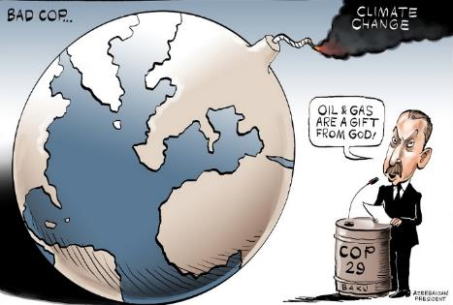
CoP 29 Outcome and Civil Society's Opinions on Future Actions
1.5 Degree Temperature Goal [Mitigation is Obscure]
Negotiation outcome
Countries failed to reach consensus on how to transition away from fossil fuels [outcome from last year's climate summit]
Forceful effort to remove the text “Ending Fossil Fuel” by Saudi Arabia but not happened
Progress is not reviewed rather the issue is ultimately struck or postponed to the next negotiating sessions
Our Observation
Mitigation needs to achieve NDCs by 2030 around US$455-584b annually
81.5% of fossil-fuel used globally as energy in 2023-[World Energy Report]
NDCs targets of polluting countries still confusing [2060-2070, etc.]
Our Recommendation
- Bangladesh review NDC-03 according to its own capacities [Not to be ambitious]
- NDCs-03 of polluting countries must be ambitious by 2025

Slide 3
CoP 29 Outcome and Civil Society's Opinions on Future Actions
Carbon markets under Article 6 of the Paris Agreement
Negotiation outcome
Agreed to fully implement carbon market after a decade of discussions
Under the Article 6.2, country-to-country will be able to easily carbon trading
Under Article 6.4, each country will develop carbon-centric market mechanism
Our Observation
Adverse effects on poor, indigenous peoples, and small farmers in MVCs
Although this benefited big countries, it is unlikely to benefit smaller countries
Is Bangladesh prepared for the carbon trading mechanism?
Possibilities Bangladesh will be exploited by developed countries
What is the priority for Bangladesh adaptation or mitigation?
Our Recommendation
- Bangladesh must prioritize adaptation, not carbon markets

Slide 4
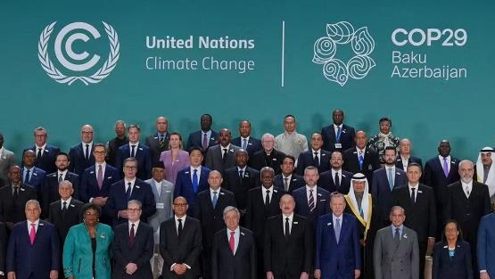
CoP 29 Outcome and Civil Society's Opinions on Future Actions
Finance; New Collective Quantified Goal [NCQG]
Negotiation outcome
$300 billion pledged is so far from the 1.3 trillion demands of MVC's
Developed world will scale up finance $1 trillion if come from private or MDB
Our Observation
Not understandable whether $300b is loan, grant or highly concessional based
Access modalities has not been decided [is it IFIs or G-G agency or GCF criteria]
Private funding 100% debt-based
Our Recommendation
- Need clear climate Finance definition [Which is climate finance which not]
Bangladesh should avoid debt-based plans; plan have to own resources based

Slide 5
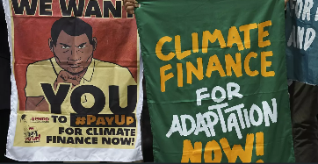
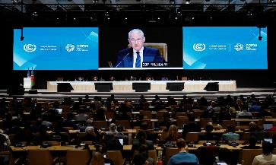
CoP 29 Outcome and Civil Society's Opinions on Future Actions
Global Goal on Adaptation [GGA]
Negotiation outcome
Countries agreed a two-year work program to determine the indicators would be used to measure progress of GGA
Our Observation
But divided happened and negotiation stuck while indicators for "means of implementation," refers to capacity-building, technology transfer and financial support for developing countries
No financial commitment for adaptation [Annually needs US$ 215-387b
Our Recommendation
Should lobby for declaration separate $300b pledged fund for Adaptation & Mitigation [50:50]
Definition of GGA not defined; lobbying to set adaptation & resilience indicators
Adopt regional based NAP by participatory process in coordination with national budget

Slide 6
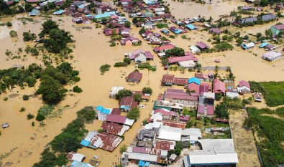
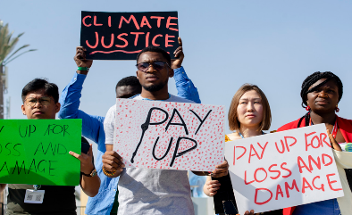
CoP 29 Outcome and Civil Society's Opinions on Future Actions
Loss and Damage Fund
Negotiation outcome
The negotiation crashed by developed countries saying the “L&D” agenda is finished in CoP 28
Our Observation
Only 729 million USD pledged to the fund which is far from the $ 447-$ 894b in yearly losses and damages anticipated by 2030
However, the fund start work from the next 2025 to disburse but question its process and easy accessibility
Our Opinion/Recommendation/ Role for BD
Bangladesh need to assess non-economic loss & damage
Lobby for easy access modality of L&D Fund not like GCF

Slide 7
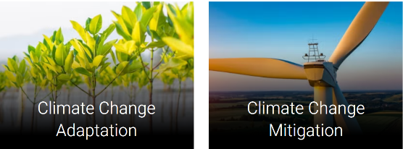
CoP 29 Outcome and Civil Society's Opinions on Future Actions
Transparency & reporting under the article-13 of PA
Negotiation outcome
Due Biennial transparency report (BTR) at COP-29
Parties will submit BTR once every 2 years but only 13 Parties have submitted
Our Observation
Enhanced Transparency Framework (ETF) reporting tools to assess effectively state wise progress
Rich countries lack their own transparency [Double counting in mitigation funds]
Our Recommendation
Each country must submitted on its Economy-Wide Carbon
Reduction Achievement Report
Need clear climate Finance definition to avoid double counting and transparency

Slide 8
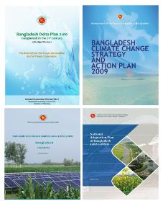
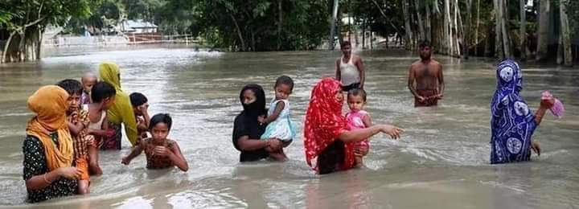
CoP 29 Outcome and Civil Society's Opinions on Future Actions
Recommendation for Next Role of Bangladesh
Bangladesh need to focus on self-dependent climate plan
Review previous plans
Regional based
Participatory process
Demand driven locally
3. Enhance good governance

Slide 9
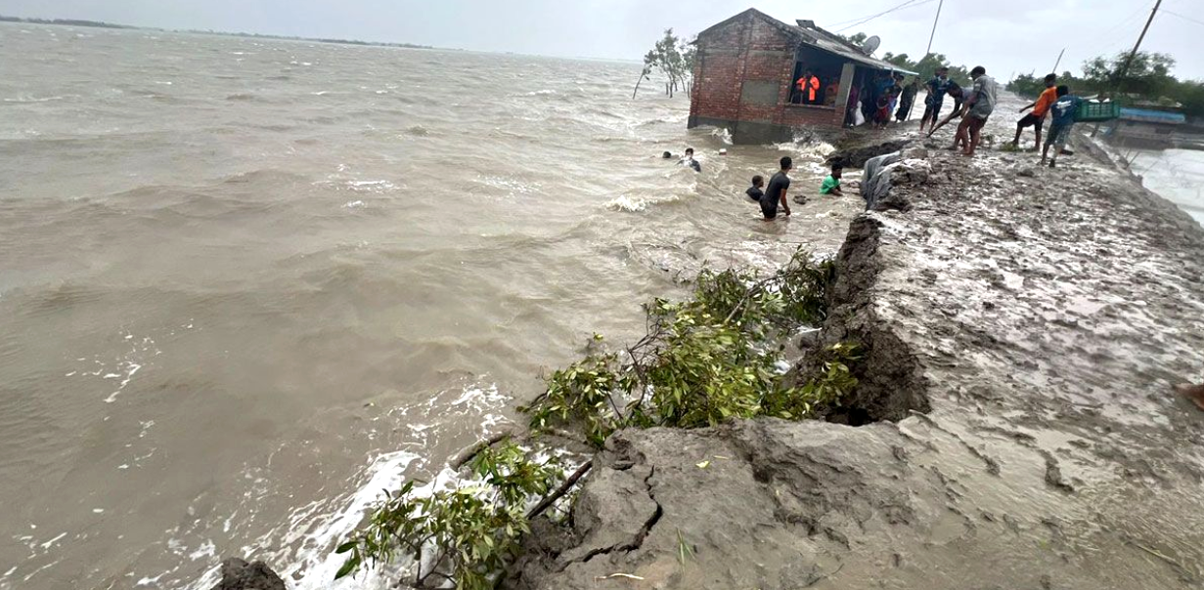
Adaptation is priority for Bangladesh to protect lives and livelihoods of millions of people…..
Let’s discuss……..

